Slide 1

BY
Boguda Devendranath
Shruthika
Shreya
E-commerce
Analysis- SQL

Slide 2
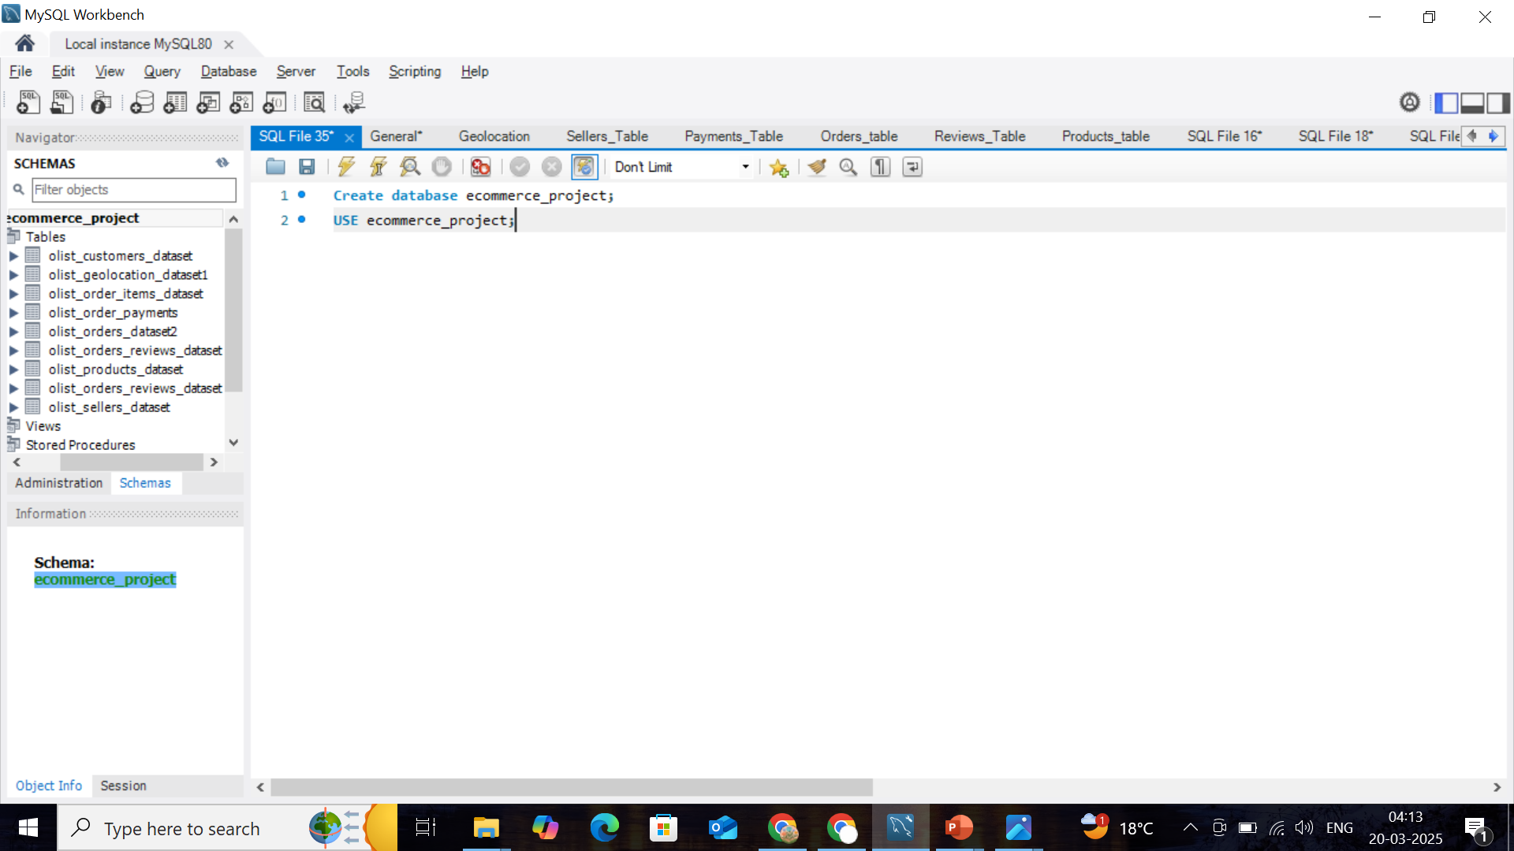
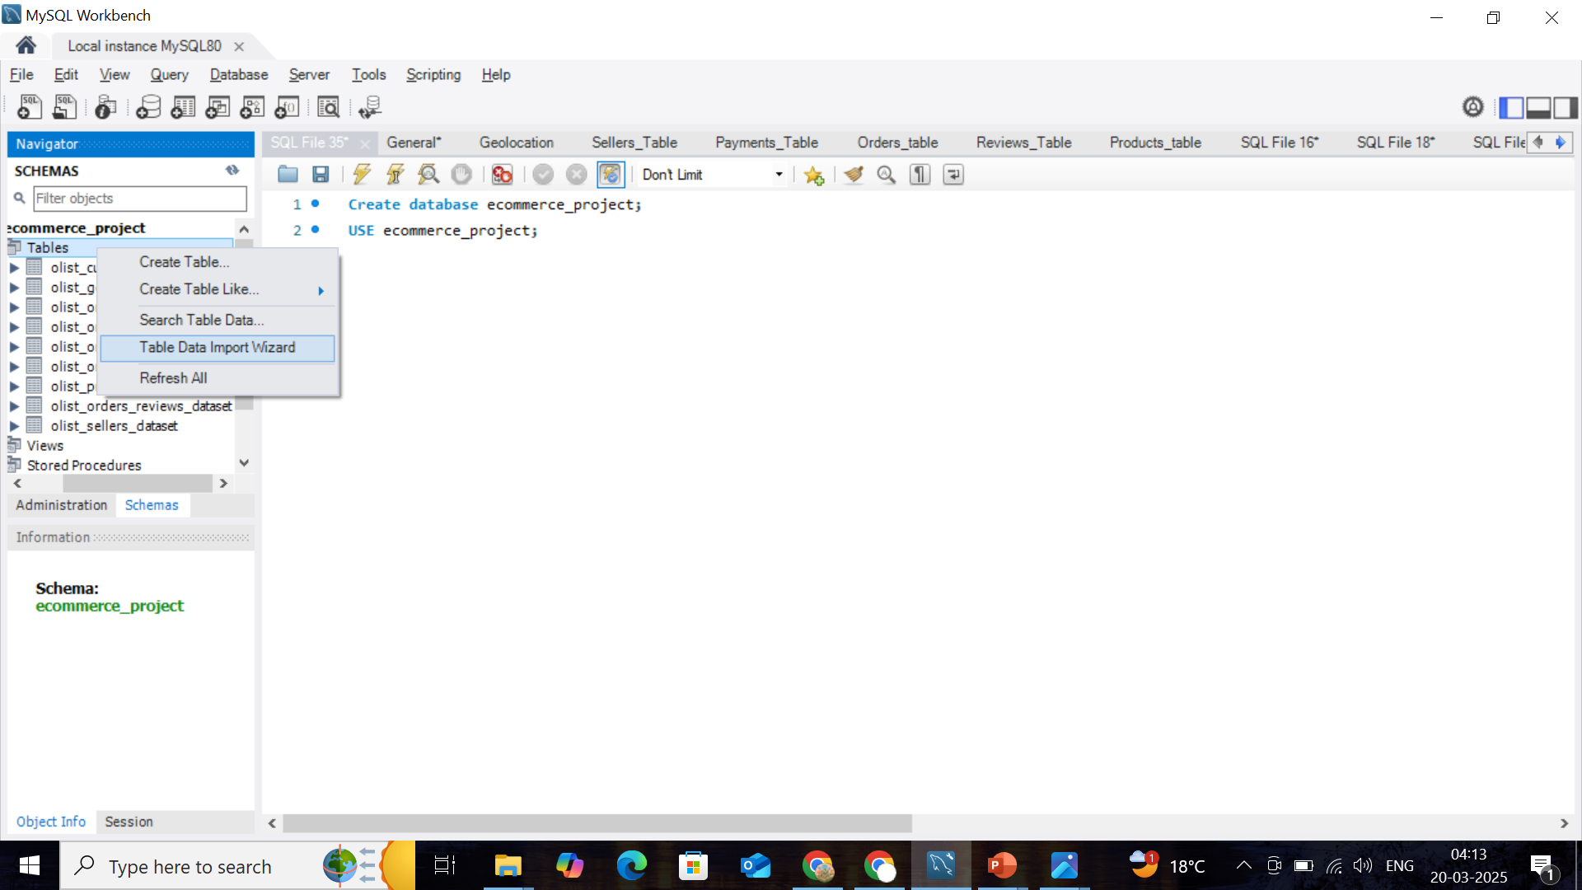
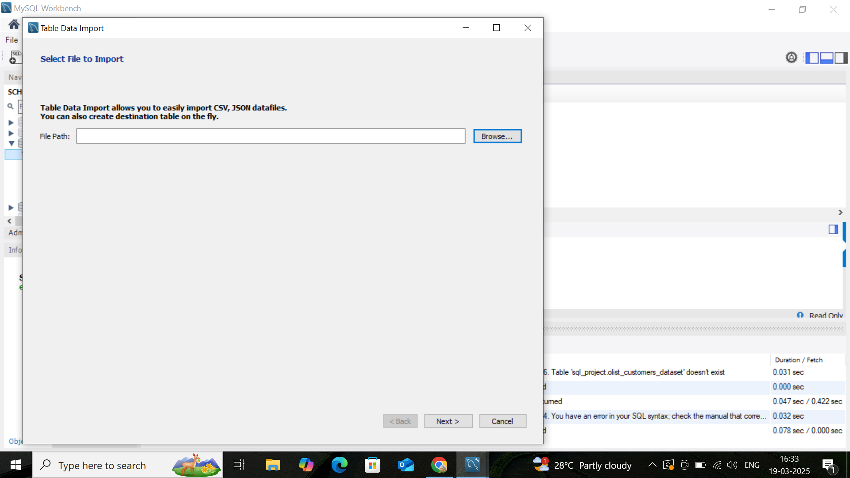
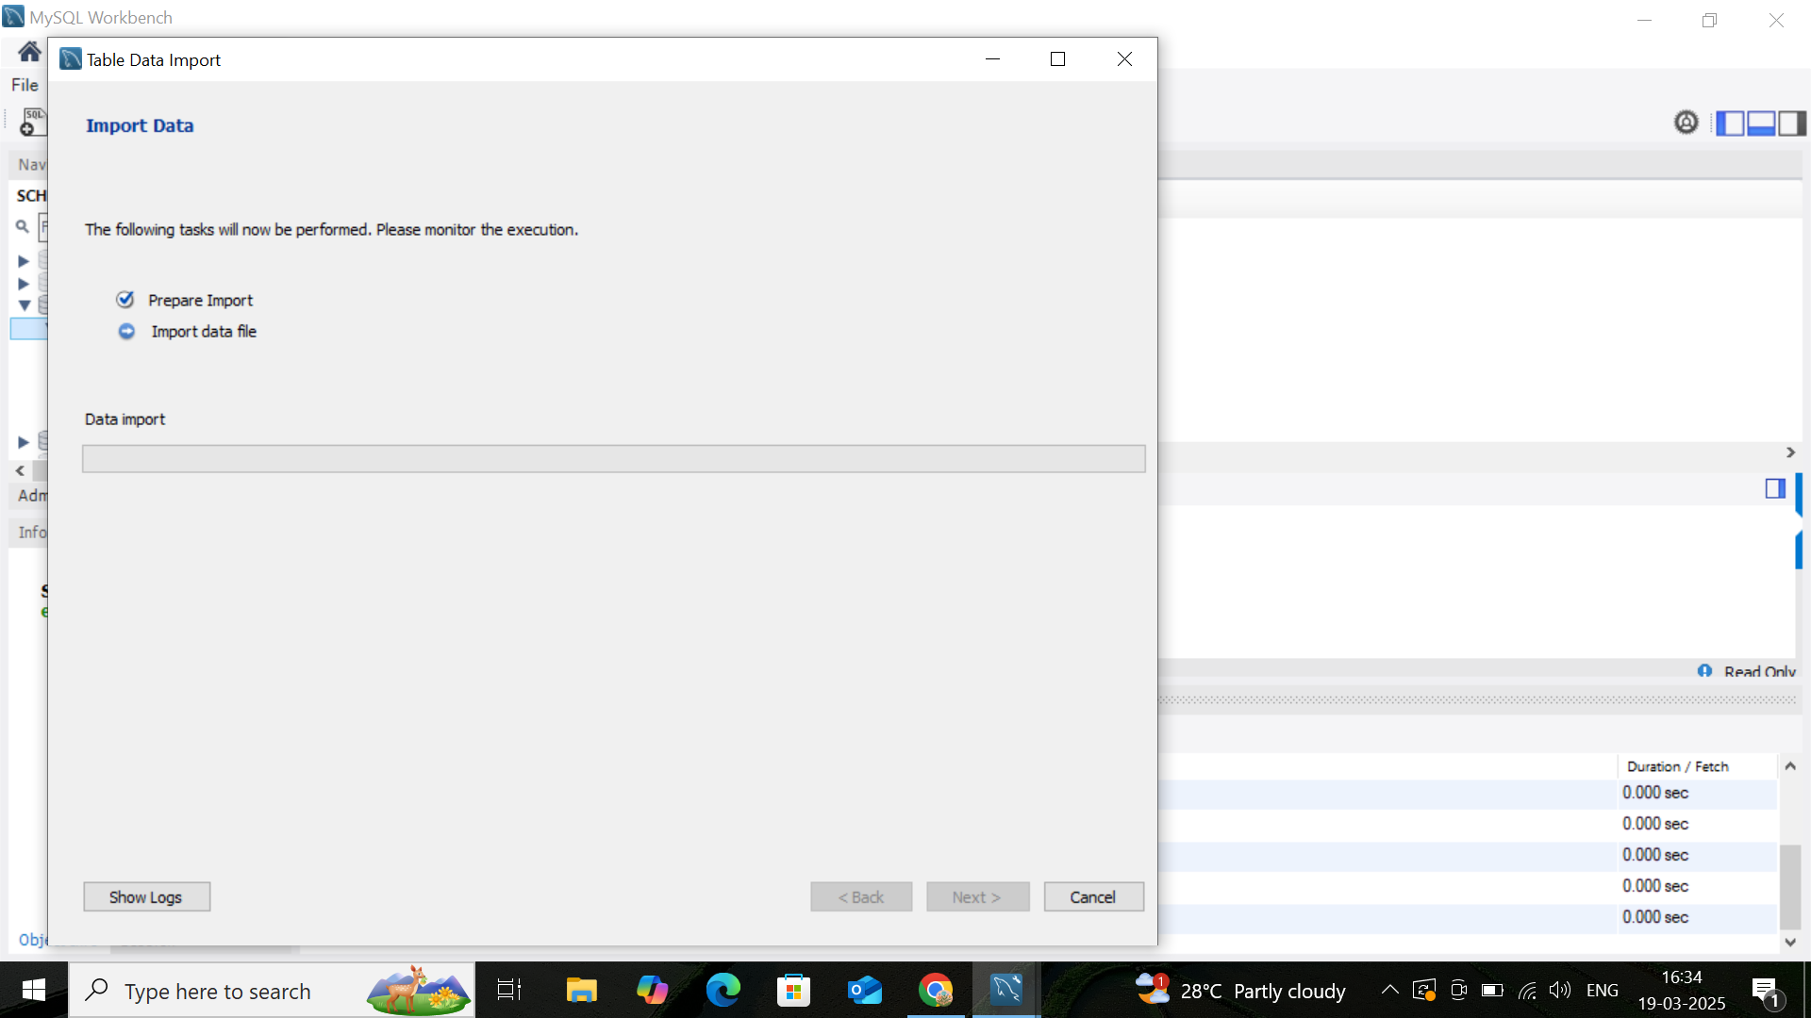

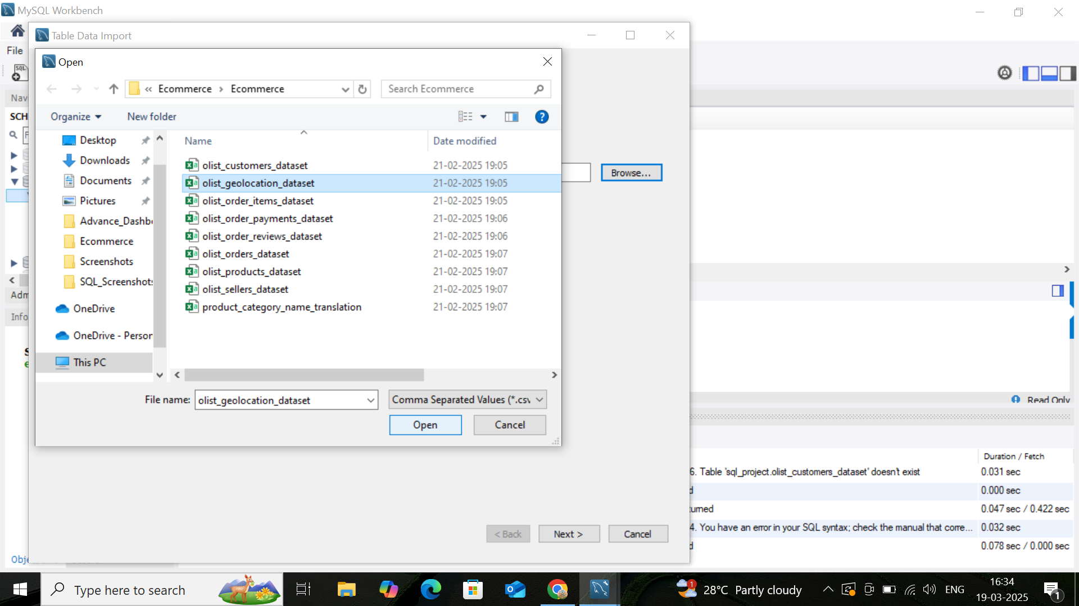
DATA BASE CREATION & DATA IMPORT

Slide 3
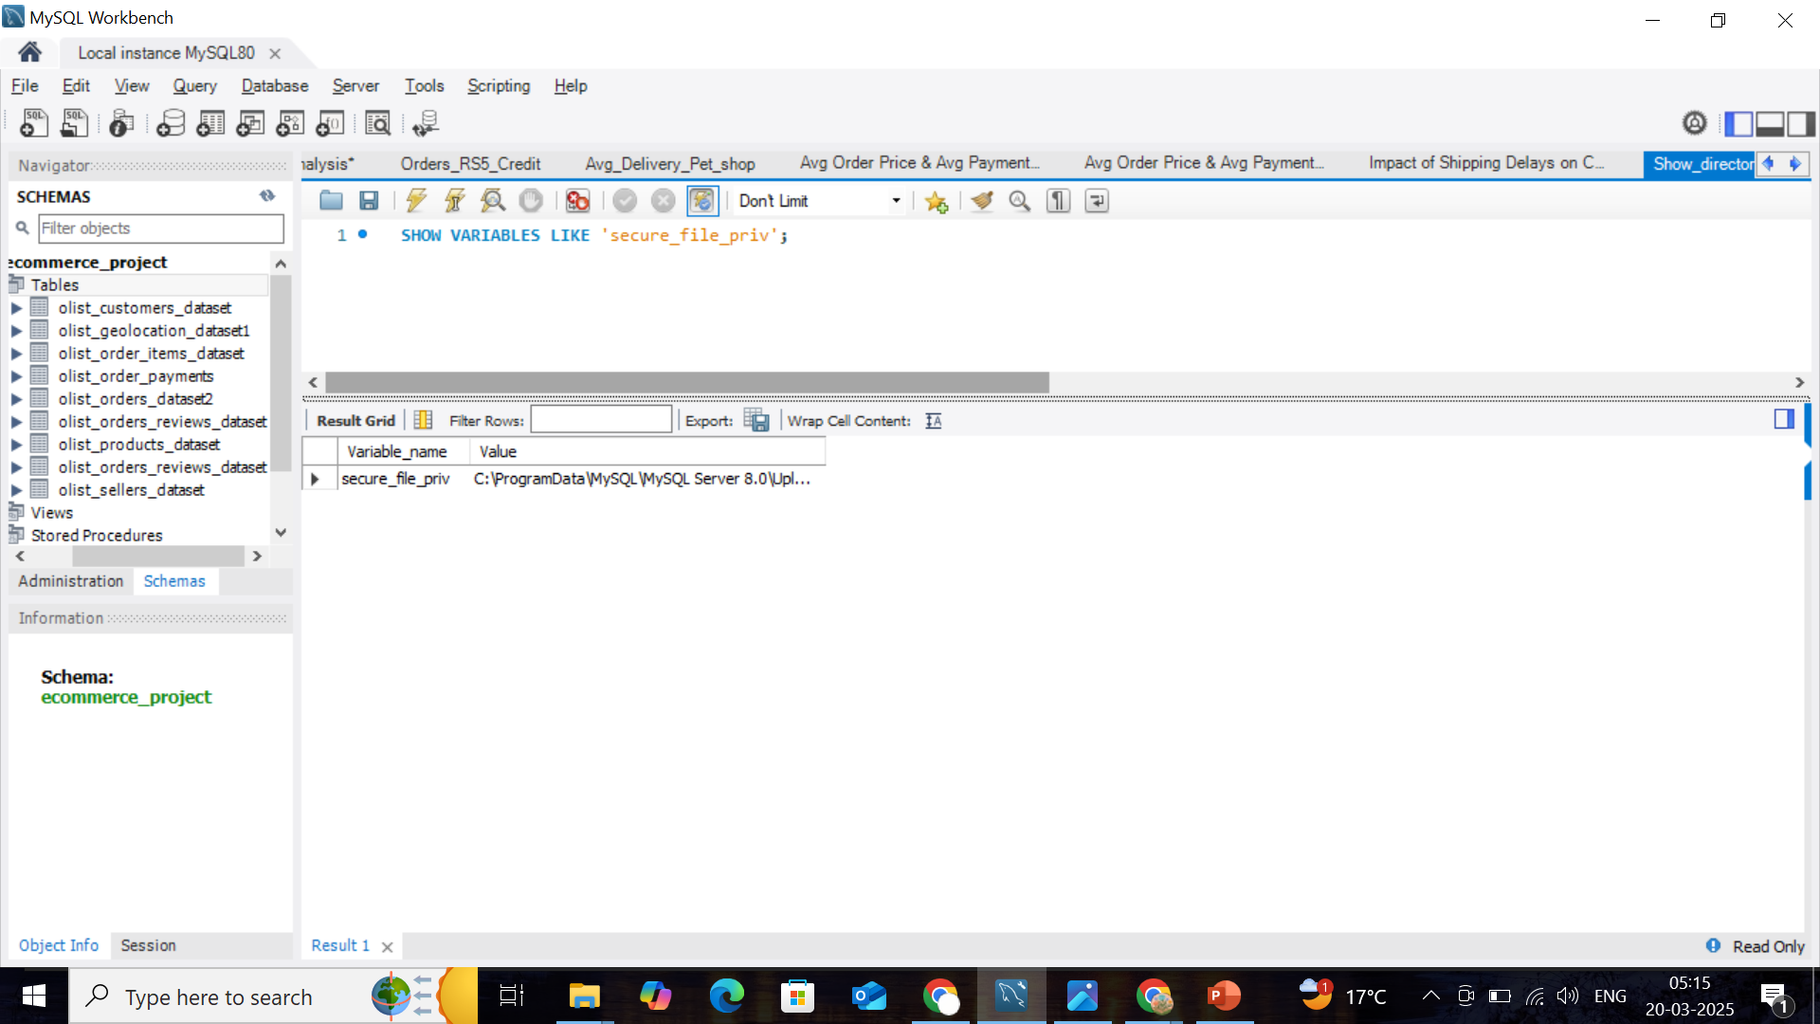
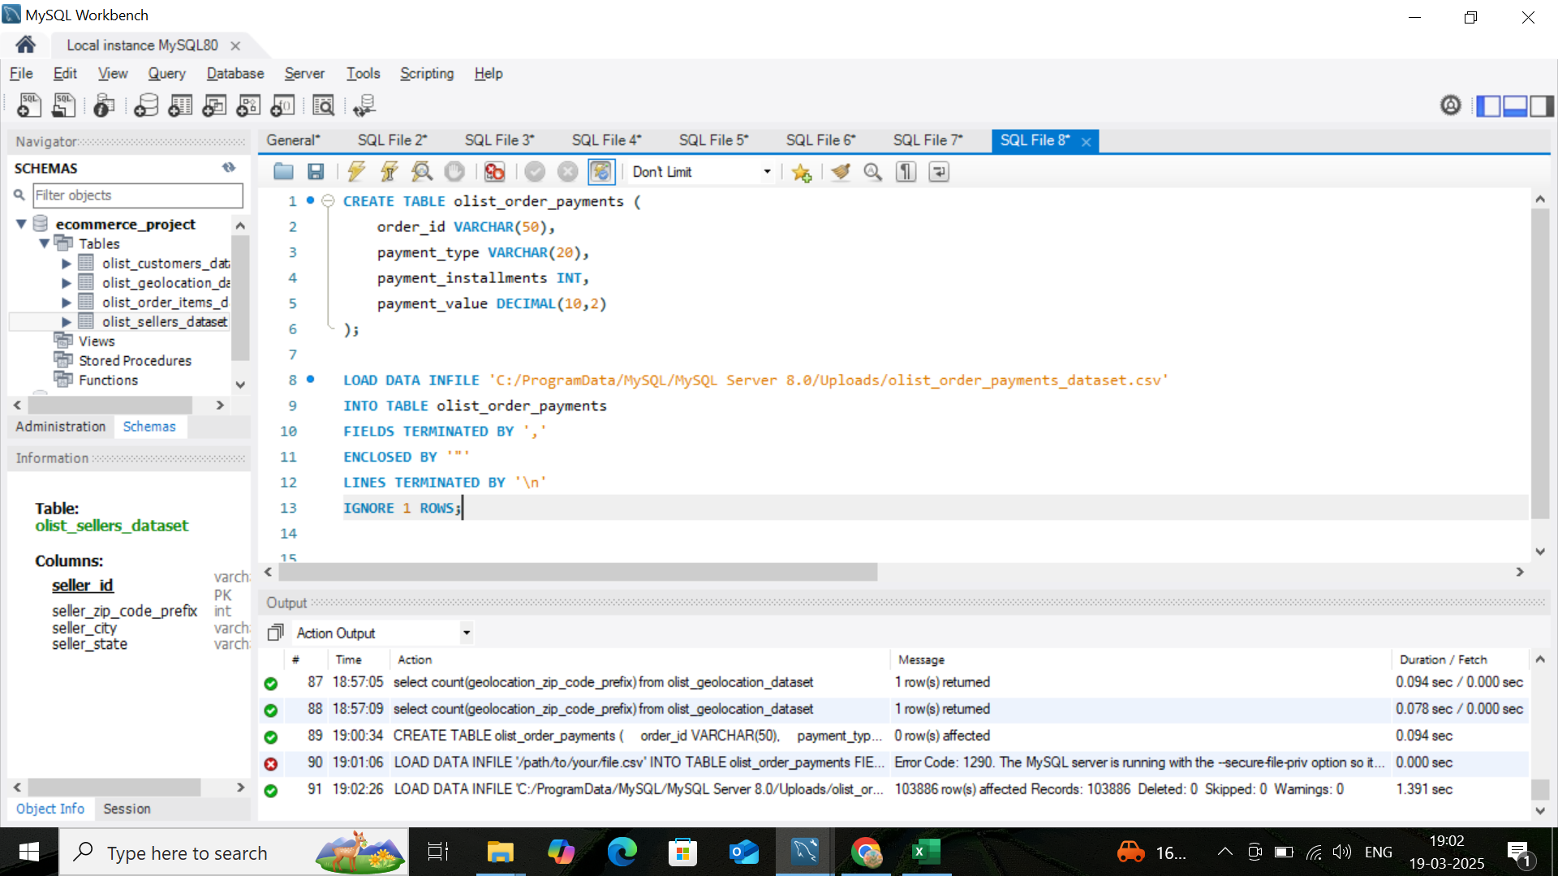
IMPORT DATA – 2nd METHOD
If you are dealing with very large datasets,
use LOAD DATA INFILE instead of Workbench imports for better performance.

Slide 4


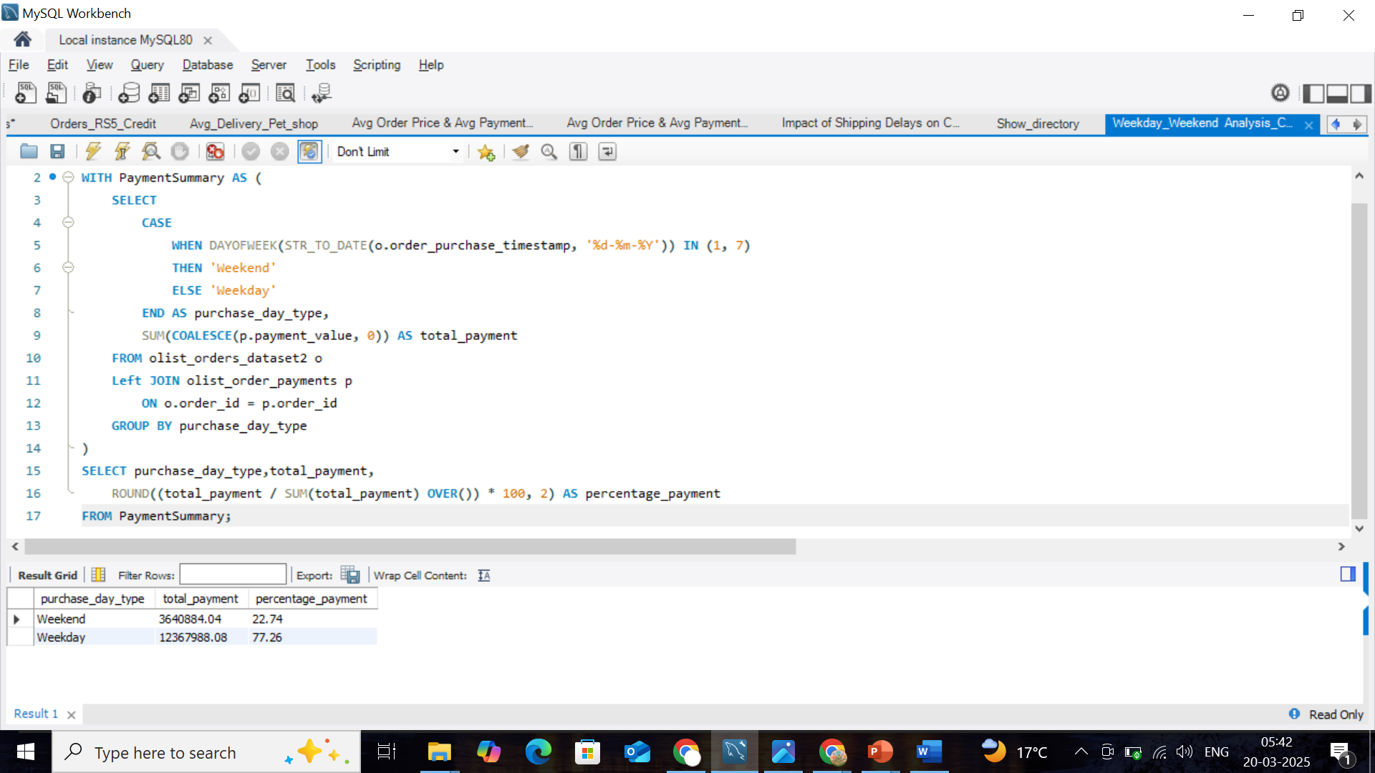
Total Payment Value: Weekday vs Weekend
CTE :
Eliminates duplication: No need to repeat the same SUM() calculation in different places.
Why Use a Window Function (SUM() OVER()) ?
Better Performance: The total sum is calculated once for all rows instead of once per row.
More Readable: No need for extra subqueries.

Slide 5
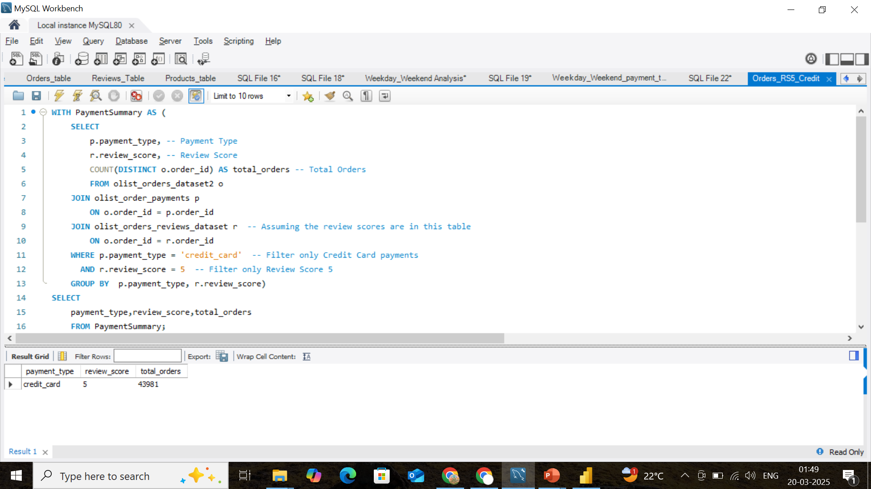
Total Orders Paid via Credit Card with 5-Star Reviews
CTE :
Create a Temporary Table (PaymentSummary) using WITH Clause.
Apply WHERE conditions:
Only credit_card paymentsOnly review_score = 5
GROUP BY :
To count distinct order_id for each payment_type and review_score
INNER JOIN :
Only orders with matching entries from all three tables.

Slide 6
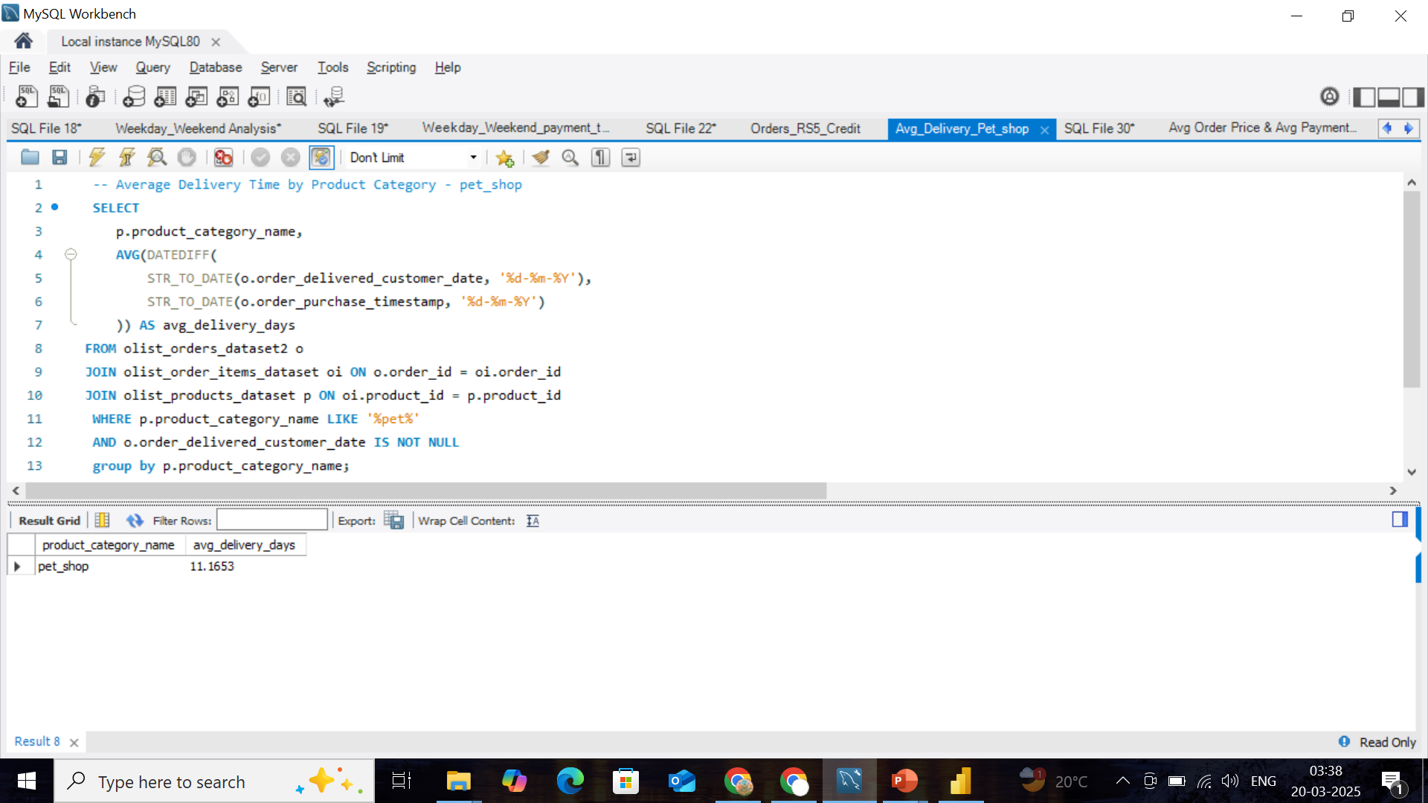
Average Delivery Time by Product Category - pet_shop
WILDCARDS Used With LIKE :
% (Percent Sign) – Matches zero, one, or multiple characters.
_ (Underscore) – Matches exactly one character.
(If you don’t know the exact category name)
GROUP BY :
Groups by the product category name.
Ensures that the average delivery time is calculated separately for each pet-related product category

Slide 7
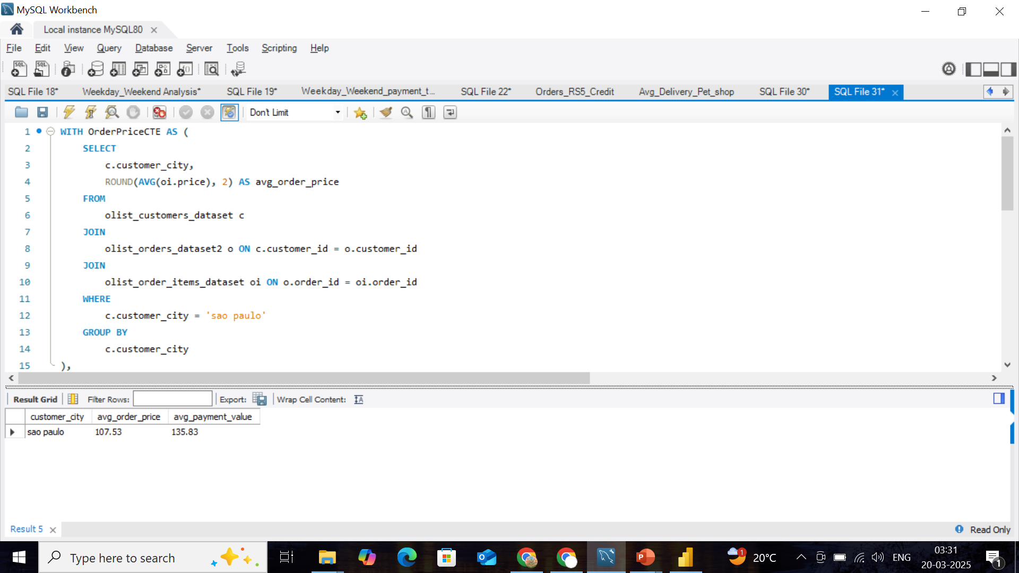
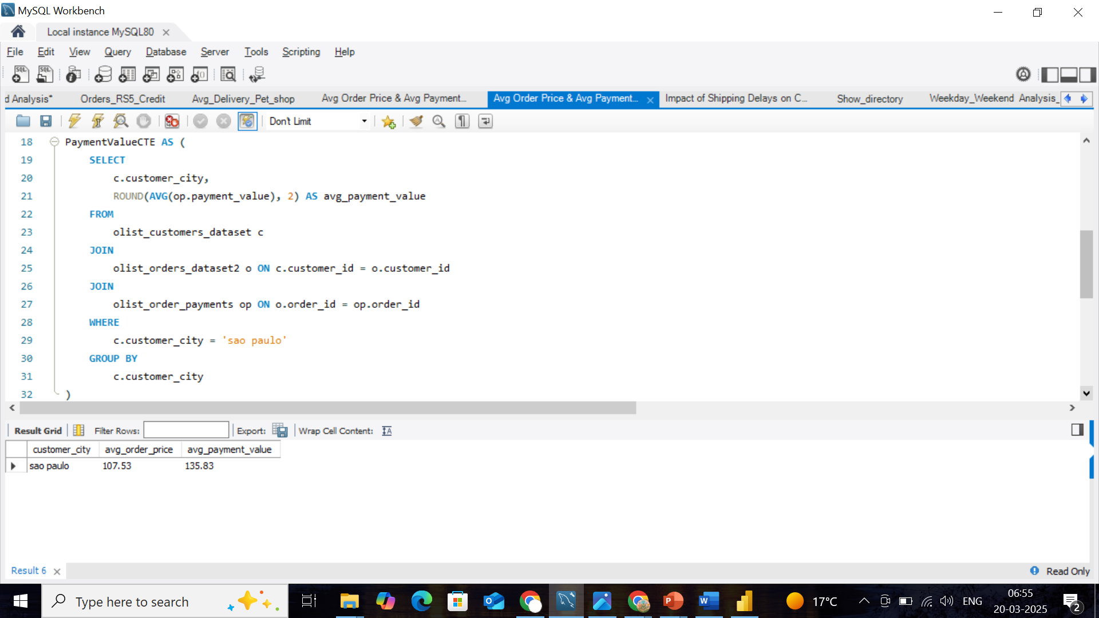
Customer Purchase Trends Across Cities: Avg Order Price & Avg Payment Value
Using Separate CTEs :
OrderPrice CTE – Calculates the average product price using only the olist_order_items_dataset.
PaymentValue CTE – Calculates the average payment value using olist_order_payments_dataset.
WE HAVEN’T USE single query :
After using joins for both tables each order_id may appear multiple times due to different numbers of items and payment transactions per order.

Slide 8
SELECT
op.customer_city,op.avg_order_price,pv.avg_payment_value
FROM OrderPriceCTE op
JOIN
PaymentValueCTE pv ON op.customer_city = pv.customer_city;

Slide 9
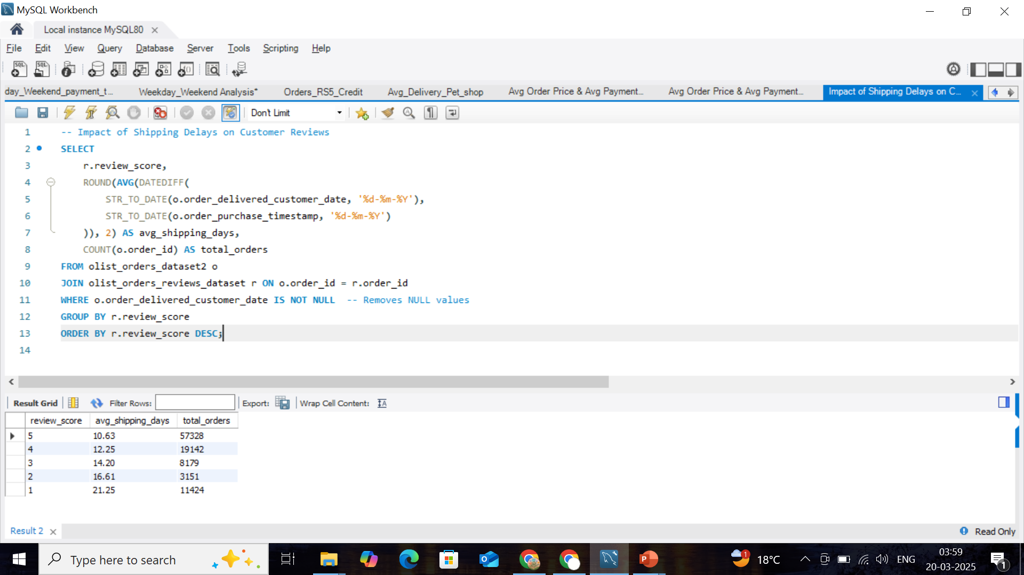
Impact of Shipping Delays on Customer Reviews
Includes COUNT(o.order_id)
AS total_orders :
Affect how aggregation is performed.
QUERY is more reliable because it ensures proper grouping and counting.

Slide 10

THANK YOU......

